Slide 1


ANNA UNIVERSITY, CHENNAI – 600 025
R.M.K. COLLEGE OF ENGINEERING AND TECHNOLOGY DEPARTMENT OF ELECTRONICS AND COMMUNICATION ENGINEERING
B.E – PRODUCT DEVELOPMENT LAB-II
SMART ROAD SAFETY SYSTEM USING DRIVER
DROWSINESS DETECTION
SDG 11 – Sustainable Cities and Communities
111624104095 - SHAIK RESHMA
111624104101 - SRI AKSHAYA.M
111624104106 - HARINMAI
111624104095 - SHAIK RESHMA
111624104101 - SRI AKSHAYA.M
111624104106 - HARINMAI.T
Under the Guidance of
Dr.S.MUTHUMANICKAM
Professor
DEPARTMENT OF ECE

Slide 2
CONTENTS
OBJECTIVES
INTRODUCTION
LITERATURE REVIEW
PROBLEM STATEMENT
PROPOSED WORK
ALGORITHM
FLOW DIAGRAM
BLOCK DIAGRAM
CONCLUSION
REFERENCES

Slide 3
OBJECTIVES
To detect driver drowsiness in real-time.
To alert the driver before an accident occurs.
To reduce road accidents caused by fatigue.
To design a low-cost and reliable safety system.

Slide 4
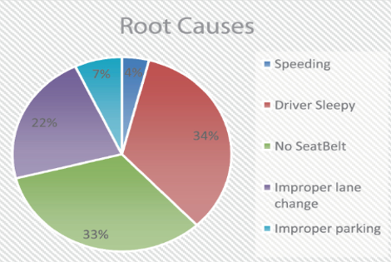
INTRODUCTION
Road accidents are increasing due to driver fatigue.
Drowsiness reduces reaction time and concentration.
Many accidents happen because drivers fall asleep while driving.
A smart detection system can help prevent such accidents.
This project uses sensors and a microcontroller to detect fatigue and give alerts.

Slide 5
Literature Review
SI.No | Title of the Paper | Year of Publication | Methodology | Pros | Cons
1 | IOT based smart driver system | 2022 | Uses microcontroller with multiple sensors and IoT module for real-time monitoring and alert system. | Real-time monitoring and remote alert possible | Requires internet connectivity.
2 | Driver Drowsiness Detection using Eye Blink Sensor | 2022 | Eye blink sensor measures eye closure duration. If eye remains closed beyond threshold, alert is generated. | Low cost, simple design, easy to implement. | May give false alert if driver blinks slowly.
3 | Embedded System Based Driver Alert System | 2021 | Microcontroller-based system activates buzzer and vibration motor when fatigue is detected. | Cost-effective and suitable for all vehicles. | Limited detection accuracy compared to AI systems.

Slide 6
PROBLEM STATEMENT
• To develop a Smart Road Accident Prevention System that detects driver drowsiness and prevents accidents.
Driver fatigue is a major cause of road accidents. Drowsiness reduces alertness and reaction time, increasing the risk of crashes. Existing systems are often expensive and complex. Therefore, a simple, low-cost, and reliable sensor-based system is needed to detect drowsiness in real-time and alert the driver to prevent accidents.

Slide 7
PROPOSED WORK
• The proposed system presents a smart and reliable solution for real-time detection of driver drowsiness to prevent road accidents.
• Sensors such as an eye blink sensor are used to monitor the driver’s condition continuously.
• A microcontroller (Arduino) processes the sensor data to identify signs of fatigue.
• If drowsiness is detected, a buzzer and warning alert are activated immediately to wake the driver and prevent accidents.

Slide 8
ALGORITHM
1). Start the system.
2). Initialize sensors and microcontroller.
3). Continuously monitor eye blink.
4). If eye remains closed for more than threshold time → detect drowsiness.
5). If drowsiness detected:
Turn ON buzzer
Then the speed of motor reduce slowly
Then stops
6). Repeat monitoring process.

Slide 9
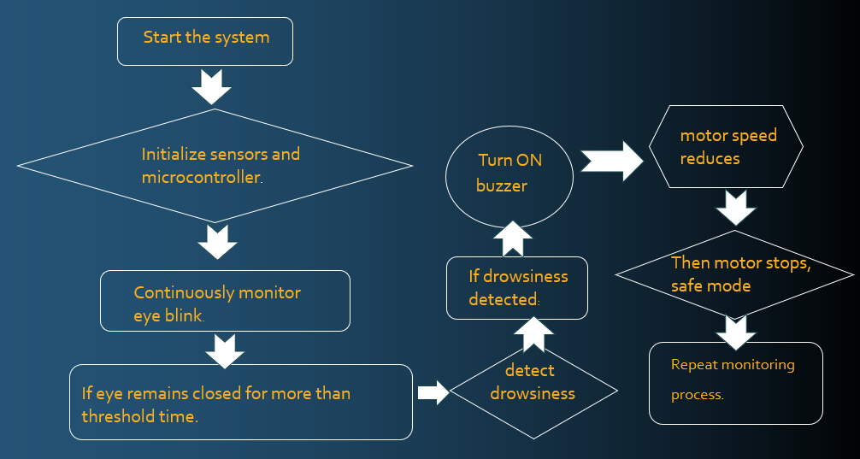
FLOW DIAGRAM

Slide 10
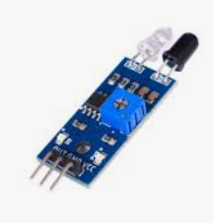
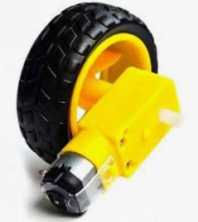
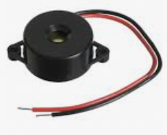
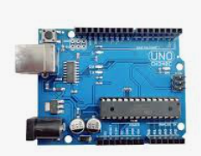
BLOCK DIAGRAM
IR Sensor (Drowsiness Detection)
DC Motor (Vehicle Simulation)
Gear Mechanism (Speed Control Simulation)
Buzzer (Alert System)
Arduino Uno (Main Controller)

Slide 11
CONCLUSION
• The Smart Road Safety System effectively detects driver drowsiness using an IR sensor.
• The system continuously monitors the driver’s eye status in real time.
• Arduino Uno processes the sensor data and makes quick decisions.
• The DC motor speed is gradually reduced to simulate safe vehicle deceleration.
• If the driver does not respond, the motor stops completely to prevent accidents.
• The system operates automatically without manual intervention.
• It helps in reducing road accidents caused by fatigue and lack of attention.
• The project uses simple, low-cost, and easily available components.
• The design is energy-efficient and easy to install in vehicles.
• Experimental testing shows accurate detection and quick response time.
• The system improves overall road safety and minimizes human error.

Slide 12
REFERENCES
World Health Organization – Global Status Report on Road Safety, Road Safety Reports.
National Highway Traffic Safety Administration – Drowsy Driving and Traffic Safety Statistics Reports.
IEEE – Research papers on Driver Drowsiness Detection Systems.
ScienceDirect – Articles on Fatigue Detection using Embedded Systems.
Springer – Journals on Smart Transportation and Road Safety Technologies.

Slide 13
THANK YOU

